Slide 1
Ch 5 sec 3
The
Industrial Revolution Begins

Slide 2
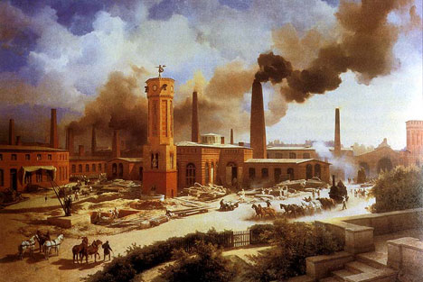
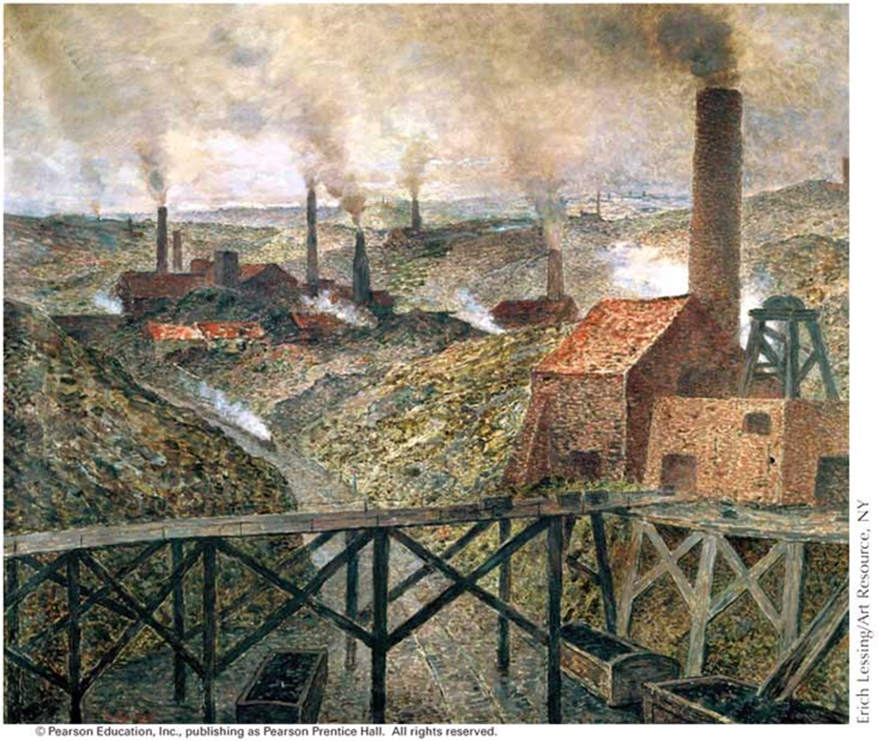
People Move to New Industrial Cities
The Industrial Revolution caused rapid urbanization in Europe and North America.
Urbanization =‘s ______________________pg. 187
the process by which towns and cities are formed and become larger as more and more people begin living and working in central areas
In the cities people coped with noise, air pollution and nasty smells.

Slide 3
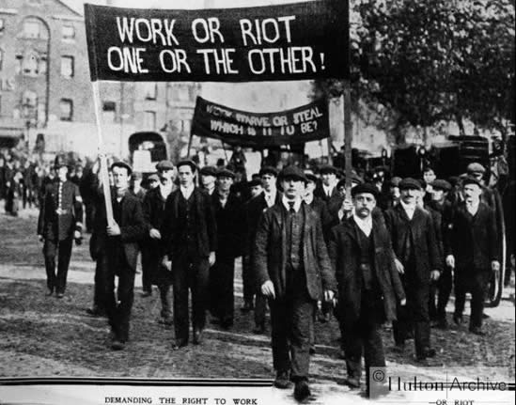
New Social Classes Emerge
The Industrial Revolution created two new classes of people: a 1. middle class of entrepreneurs whose lifestyles were fairly comfortable and an industrial 2. working class, who packed into tenements without running water or sanitation systems.
Some British workers staged riots in the early 1800s in protest of poor pay or working conditions. Methodism became a solace to many of the workers.

Slide 4
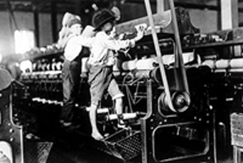
Life in the Factories and Mines
Days were long in the factories and mines and days off were few. Accidents maimed people; dust in the mines made people sick.
Women workers had no rest between factory and home work. Children also worked to keep food on the table.
Employers could pay women less so they were a large majority of early factory workers (BM?)
http://www.history.com/topics/industrial-revolution/videos/characteristics-of-early-factory-girls?m=528e394da93ae&s=undefined&f=1&free=false Characteristics of Early Factory Girls

Slide 5
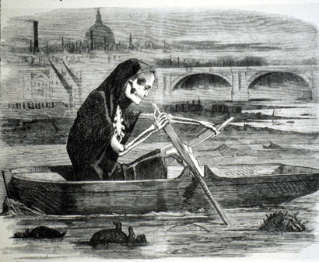
Problems of Pollution
The Silent Highwayman - 1858

Slide 6
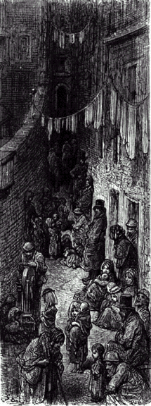
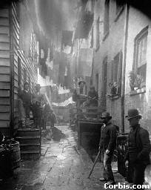
New Industrial City

Slide 7
As cities grew, people crowded into tenements and row houses such as these in London.
by Gustave Dore

Slide 8
II. Workers
A. Many were women=
1. employers could pay them less
B. Poor wages, long hours
(1. 12-14 hours, 6 days a week)
C. Dangerous/unsanitary conditions

Slide 9
Factory Workers at Home

Slide 10
Factory Wages in Lancashire, 1830
Age of Worker | Male Wages | Female Wages
under 11 | 2s 3d. | 2s. 4d.
11 - 16 | 4s. 1d. | 4s. 3d.
17 - 21 | 10s. 2d. | 7s. 3d.
22 - 26 | 17s. 2d. | 8s. 5d.
27 - 31 | 20s. 4d. | 8s. 7d.
32 - 36 | 22s. 8d. | 8s. 9d.
37 - 41 | 21s. 7d. | 9s. 8d.
42 - 46 | 20s. 3d. | 9s. 3d.
47 - 51 | 16s. 7d. | 8s. 10d.
52 - 56 | 16s. 4d. | 8s. 4d.
57 - 61 | 13s. 6d. | 6s. 4d.

Slide 11
Your task
Draw a timeline showing a typical school day. Include breaks and travelling times as well as leisure time after school and the time you normally go to bed.
9:30 am break
6:30 am
get up
8:00 am
start school

Slide 12
Compare your daily routine with that of a factory girl working in Lancashire 1820. How are they different?

Slide 13
Daily routine
Click to compare with daily routine of working girl in 1820s Lancashire
Hour of rising 5.45pm
Interval for breakfast 6.30-7-.00am
Time for work 7.00-12.00pm
Interval for dinner 12.00-1.00pm
Time for work 1.00-6.00pm
Interval for supper 6.00-7.00pm
Time for going to bed 8.00pm

Slide 14
This is Thurgarton Workhouse in Nottinghamshire. Remembering that most working class people lived in cramped, overcrowded houses with poor sanitary conditions, how do you think people might have felt when they were told they were going to work and live in a workhouse similar to this one?

Slide 15
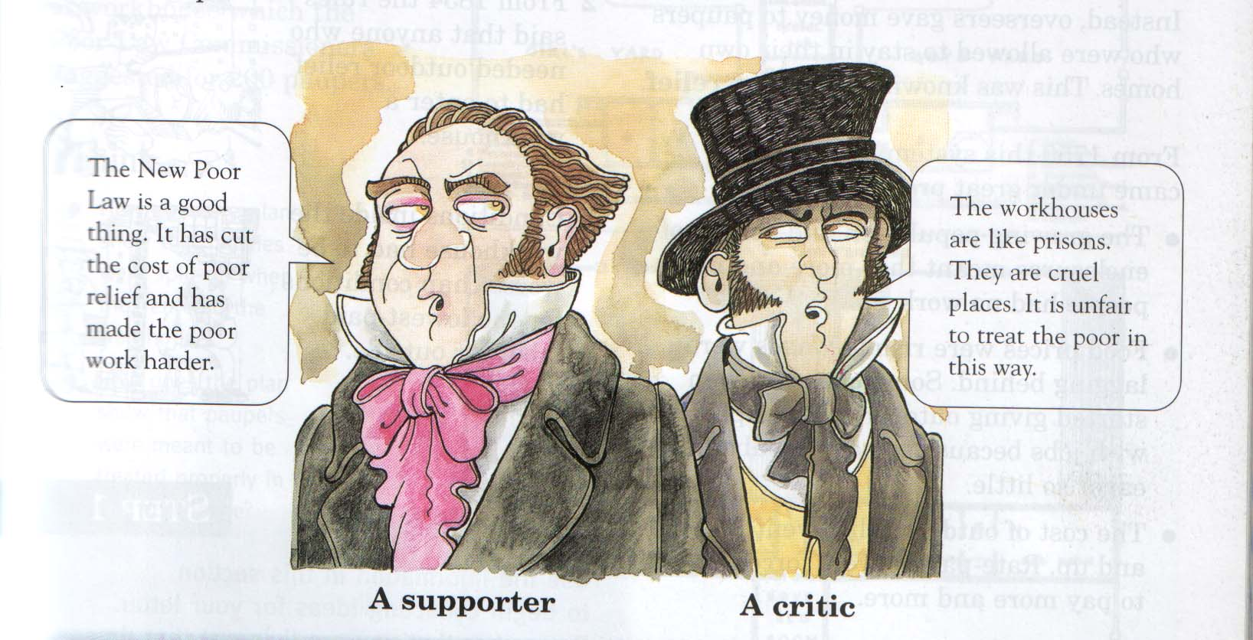
Were workhouses so bad?

Slide 16
Worker Housing in Manchester

Slide 17
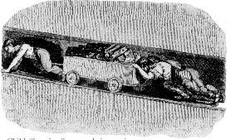
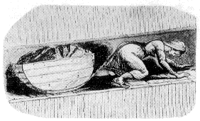
Child Labor in the Mines
Child “hurriers”
http://www.history.com/topics/child-labor

Slide 18
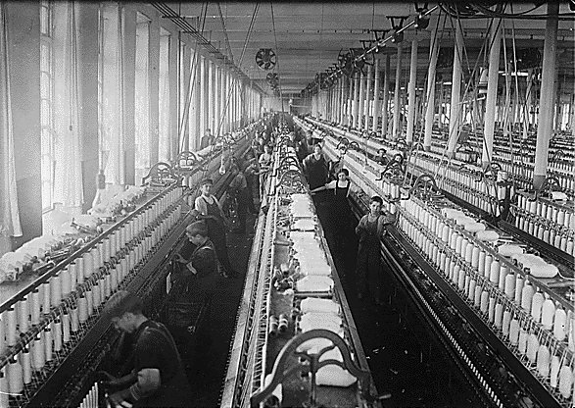
A general view of spinning room, Cornell Mill, Fall River, Mass., c.1908.
Notes:
A general view of spinning room, Cornell Mill. Fall River, Mass.

Slide 19
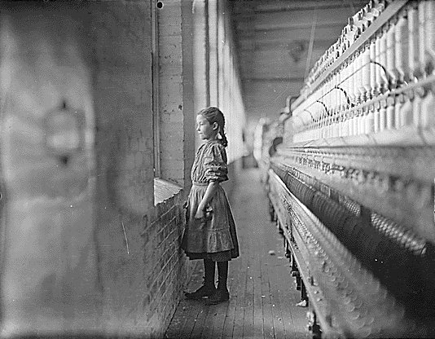
Rhodes Manufacturing Company
Lincolnton, N.C., c.1908.
A moment’s glimpse of the outer world. Said she was 11 years old. Been working over a year.
http://www.history.com/topics/holidays/labor-day/videos/history-of-labor-day
Notes:
A moments glimpse of the outer world. Said she was 11 years old. Been working over a year. Rhodes Mfg. Co. Lincolnton, N.C.

Slide 20
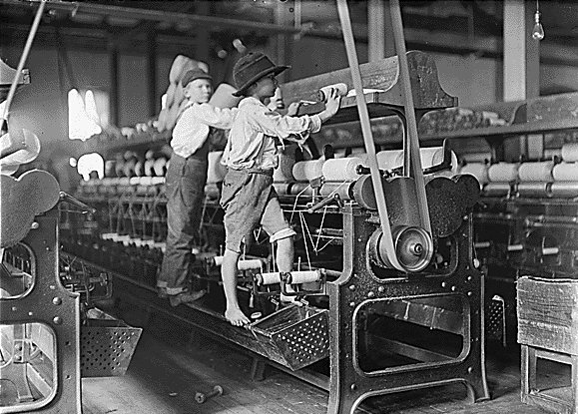
Bibb Mill No. 1.
Macon, Ga., c. 1908.
Some boys and girls were so small they had to climb up on to the spinning frame to mend broken threads and to put back the empty bobbins.
Notes:
Some boys and girls were so small they had to climb up on to the spinning frame to mend broken threads and to put back the empty bobbins. Bibb Mill No. 1. Macon, Ga.

Slide 21
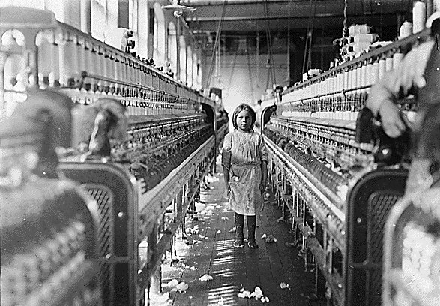
The overseer said apologetically, "She just happened in." She was working steadily. The mills seem full of youngsters who "just happened in" or "are helping sister.” Newberry, S.C., c.1908.
Notes:
The overseer said apologetically, "She just happened in." She was working steadily. The mills seem full of youngsters who "just happened in" or "are helping sister." Newberry, S.C.

Slide 22
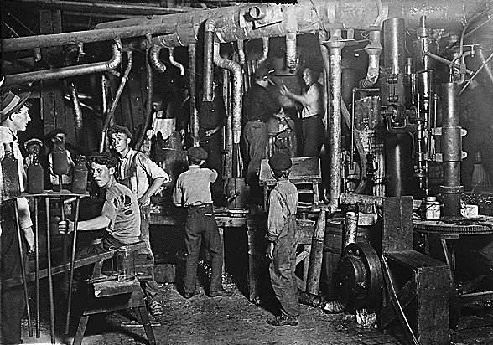
9:00 p.m. at an Indiana glass works, c.1908.
Notes:
9 p.m. in an Indiana Glass Works.

Slide 23
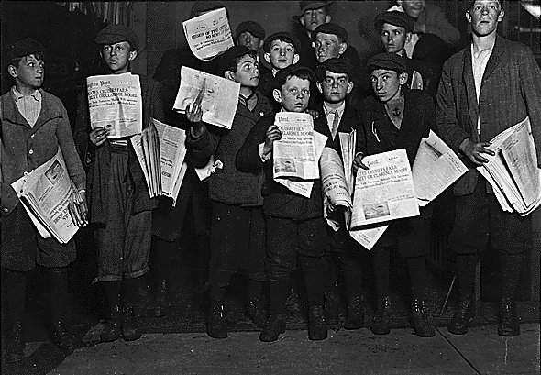
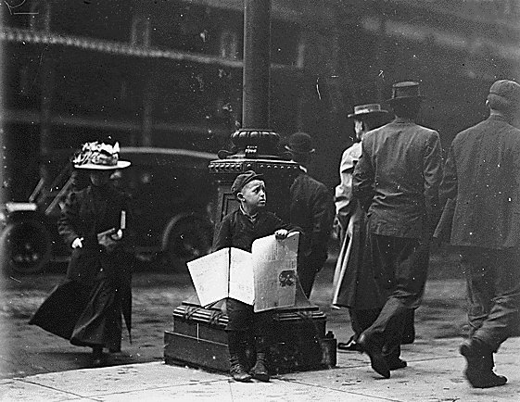
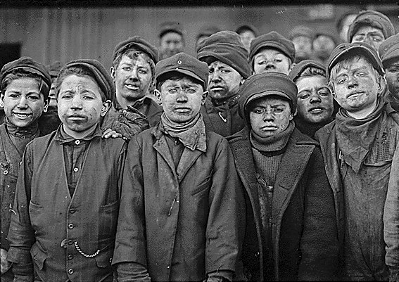
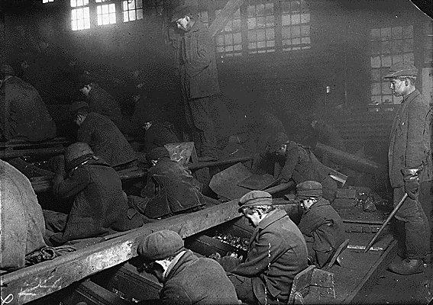

Slide 24
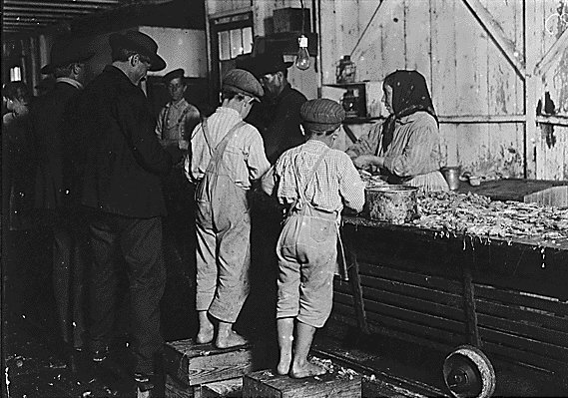
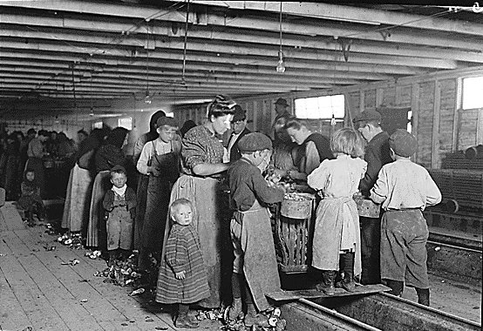
Peeling Shrimp

Slide 26
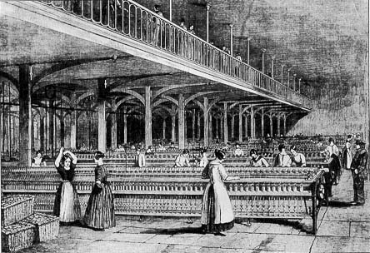
Textile Factory

Slide 27
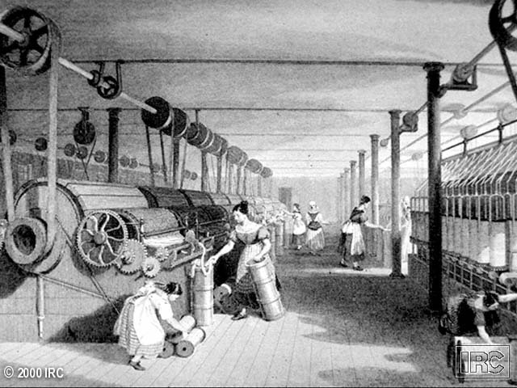
Young “Bobbin-Doffers”

Slide 28
11/5/09 Inventions PPT World History Standard: 10.3.2
Examine how scientific and technological
changes and new forms of energy
brought about massive
social, economic and cultural change
Example:
Inventions and discoveries of
James Watt, Eli Whitney, Henry Bessemer,
Louis Pasteur, and Thomas Edison

Slide 29
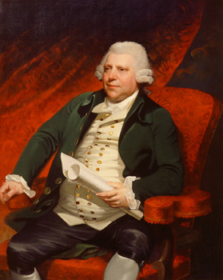
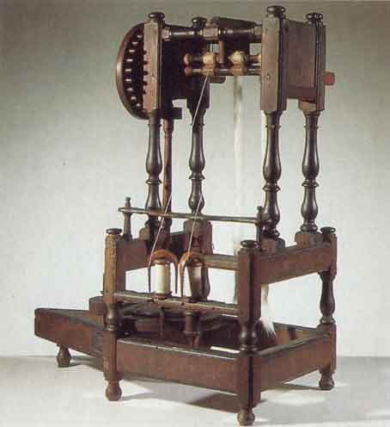
Richard Arkwright: “Pioneer of the Factory System”
The “Water Frame”

Slide 30
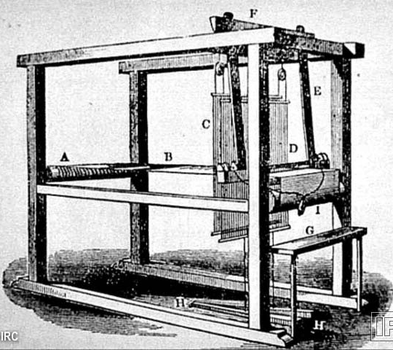
John Kay’s “Flying Shuttle”

Slide 31
I. James Watt’s Steam Engine
Steam: better source of power
Units of Power named in his honor
1. watts

Slide 32
Steam Tractor

Slide 33
Steam Ship

Slide 34
Early Steam Locomotive

Slide 35
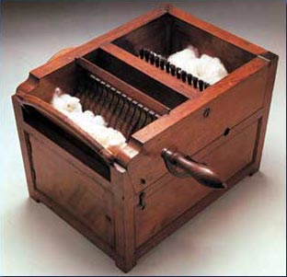
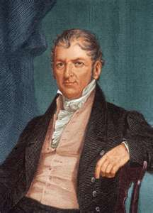
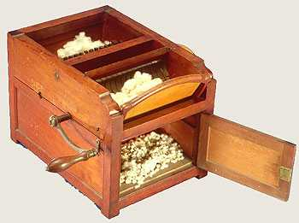
II. Eli Whitney
A. Invented the Cotton Gin
1. increased cotton production
2. takes the seeds out

Slide 36
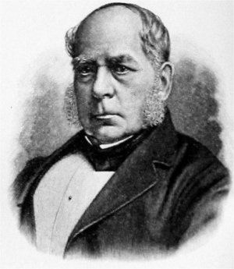
III. Henry Bessemer
A. Bessemer Process
1. Quick/cheap steel out of iron
2. used 4 train tracks, bridges etc
https://www.youtube.com/watch?v=dypdoLm4Rn8&list=PLG41HV5r0aEKYd6yd6R6GUSb2ksZJnwix&index=4 Bessemer Converter

Slide 37
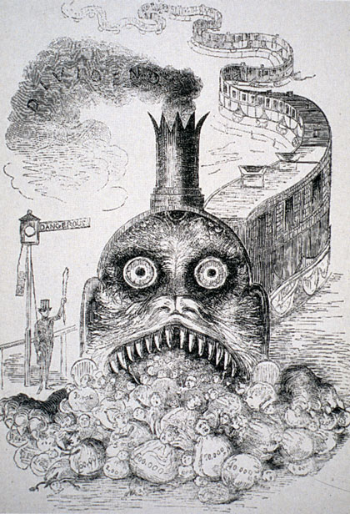
“The Great Land Serpent”

Slide 38
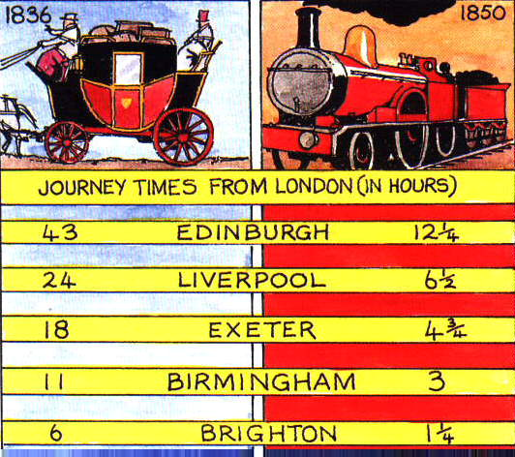
The Impact of the Railroad

Slide 39
IV. Railroads
A. Better steel (Bessemer Process)
B. Trains didn’t have to follow a river
George Stephenson's Rocket locomotive. Photograph, 19th century.
https://www.youtube.com/watch?v=RhDSERcl8ZI Stephenson's Rocket HD

Slide 40
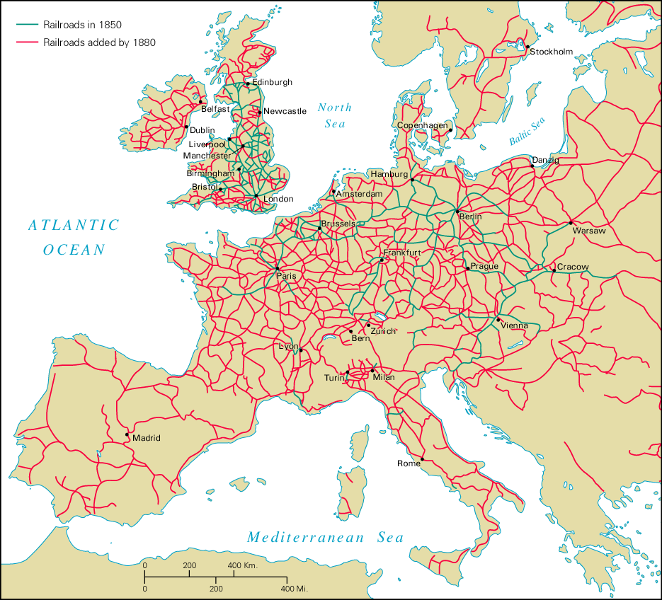
Railroads on the Continent

Slide 41
V. Louis Pasteur
A. Pasteurization (sterilization of liquids)
1. Increased life of products
i. ex: milk
B. Germ Theory
1. Certain microbes cause infection

Slide 42
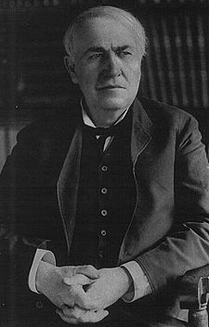
"Genius is one percent inspiration, ninety-nine percent perspiration."
- Thomas Alva Edison,
Harper's Monthly (September 1932)

Slide 43
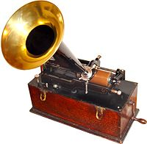
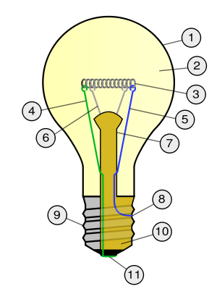
VI. Thomas Edison
A. Invents the phonograph, light bulb
 | Outline of Glass bulb Low pressure inert gas (argon, neon, nitrogen) Tungsten filament Contact wire (goes out of stem) Contact wire (goes into stem) Support wires Stem (Glass mount) Contact wire (goes out of stem) Cap (Sleeve) Insulation (Vitrite) Electrical contact
Edison cylinder phonograph ca. 1899

Slide 44
World History Standard: 10.3.4
Trace the evolution of work and labor, including the demise of the slave trade and the effects of immigration, mining and manufacturing, division of labor and the union movement.

Slide 45
Did conditions get better?
1831 govt. inquiry into children’s working conditions in factories
1833 Factory Act passed:
No children under 9, limit of 9 hrs work & 2 hrs schooling
1842 Mines Act banned employment of women & children (under 10) in coal mines

Slide 46
1819 Factory Act
No children under 9 to work in factories. Children from 9 to 16 allowed to work a maximum of 72 hours per week with one and a half hours a day for meals.

Slide 47
1833 Althorp`s Factory Act
Children from 9 to 13 to work a max of 42 hrs per week; also children 13 to 16 to work a maximum of 69 hours a week. No night work for anybody under the age of 18.

Slide 48
1842 Mines and Collieries Act
Banned all women and children under 10 from working underground. No-one under 15 years was to work winding gear in mines.

Slide 49
1847 Fielder`s Factory Act
10 hour day introduced for under 18's and for women.

Slide 50
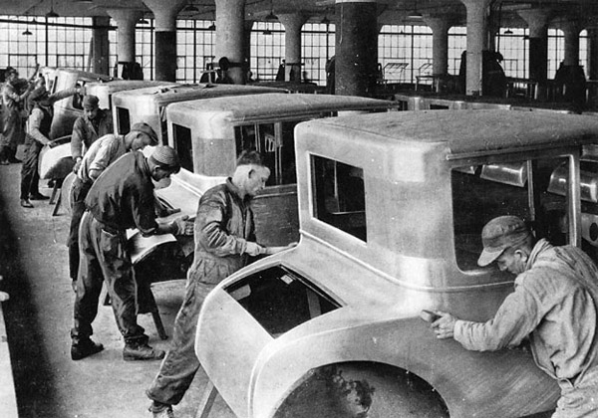
The Results of Industrialization
In time, the Industrial Revolution also benefited many working-class people.
When wages rose, many could afford entertainment and travel in addition to food and shelter.
There were 3 factors of
production that drove the I.R. BM ?
Land
Labor
Capital

Slide 51
The Results of Industrialization
Poor wages & working conditions lead to labor unions

Slide 52
Tremendous Sacrifice

Slide 53
Review ?’s
What was a major cause of growth of cities during the I.R.?
Those who benefited most from the I.R. were?
Luddites, who smashed machines in Britain, were groups of…
Why did factory owners often prefer to hire women?
List some of the major hazards of working in a textile factory. (2-3)
British inspectors made sure what were being followed between the 1830’s & 40’s?
Name one positive effect to workers during the IR?

Slide 54
answers
3 pts
/21

